Slide 1

Data Visualization and Dashboards with Tableau
Omoyemen Obokhare
September
2023

Slide 2

Steps Taken
Downloaded the Dataset
Opened with Tableau
Data Exploration with Tableau
Worked with the project specifications( Answering the questions)
Data Manipulations
Data and Visualisation created

Slide 3

Project Intention
The project aimed to develop dashboards by utilizing data on Real Estate Prices and Incomes from different Canadian districts, incorporating various visualizations and insights. These dashboards aimed to provide stakeholders and end users with a comprehensive understanding of the trends in real estate prices across Canada's districts over time, allowing for meaningful comparisons with changes in income levels throughout the years.
.

Slide 4
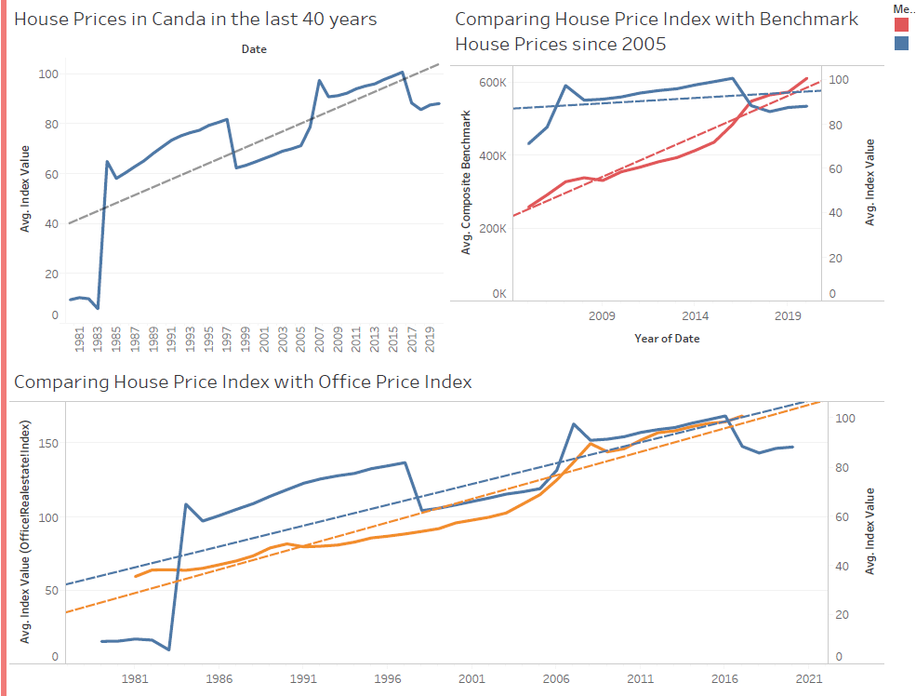

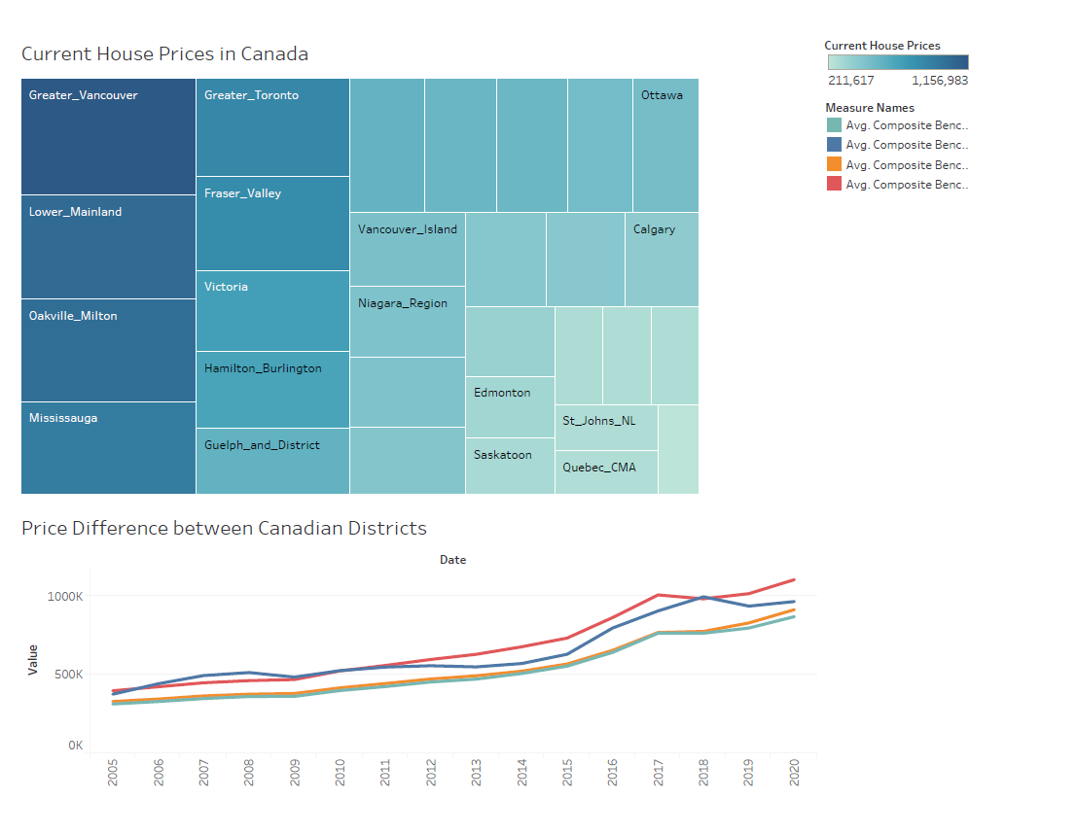
Outcomes

Slide 5
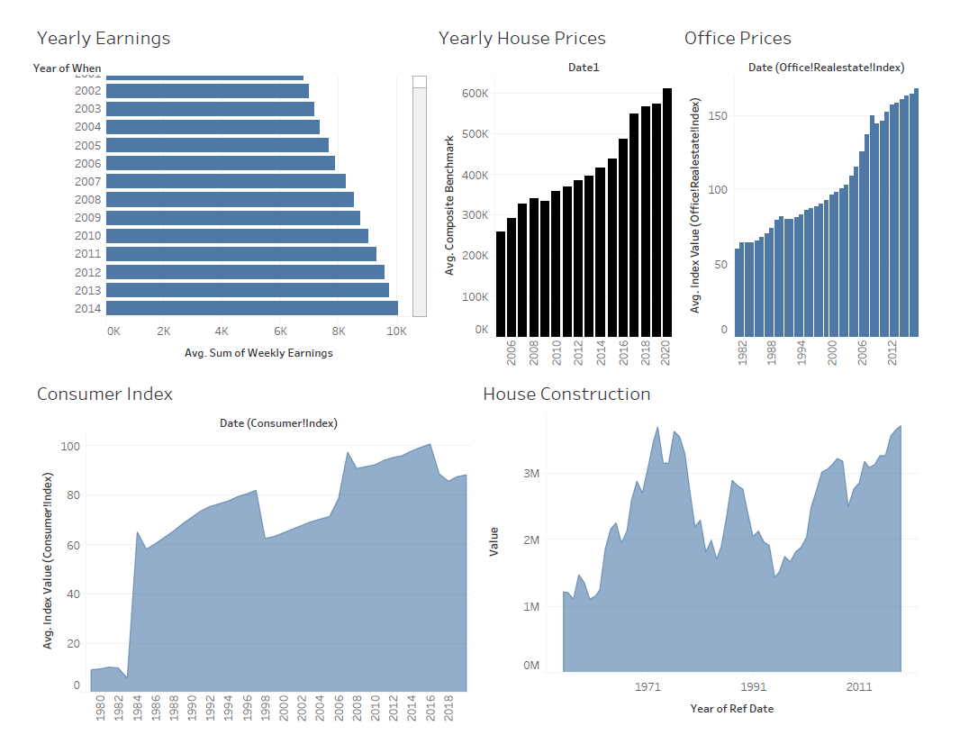
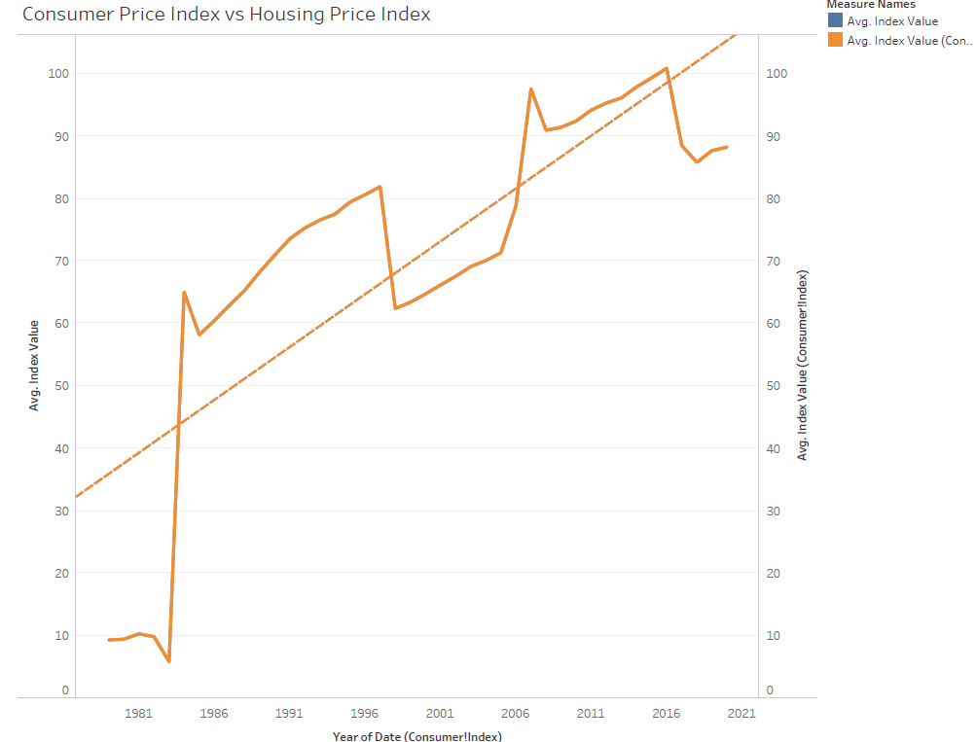
Outcome Continued

Slide 6

Struggles and Learning Curve
I encountered some challenges in manipulating data within Tableau but I know it might be due to my first time experience and I know I will improve with continued practice.
Additionally, I experienced limitations in selecting specific visualizations as they were grayed out, although I'm uncertain if this is related to the version of the application I have as I utilized the free trial on Tableau.

Slide 7

End of Presentation
Omoyemen Joy

